Slide 1
Introduction of Data
BY: Rupesh Jawade

Slide 2
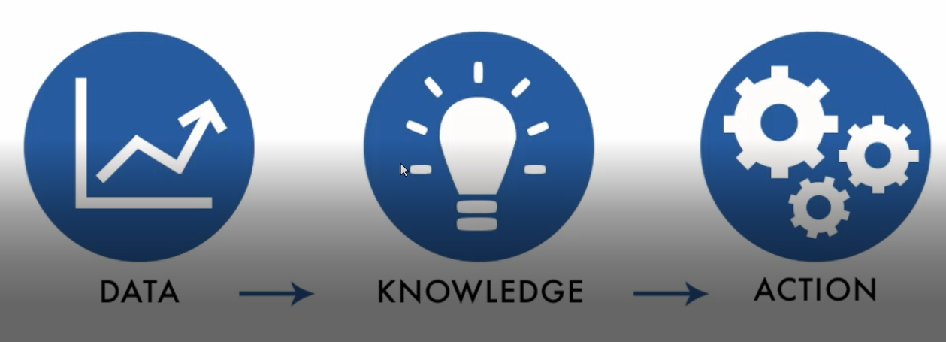
1.What is data ?
Everything which is present around us ,and that thing arrange in meaning full manner is called “Data”.
Data is a information or collection of facts (number ,words, measurement and observation , images, ) that has been translate into a form for that computer can process.

Slide 3
What is information ?
When data are processed, organized, structured or presented in a given context so as to make them useful, they are called “information”.
Information is data that has been processed in such a way as to be meaningful to person who receives it .it is anything that is communicated

Slide 4
2.Differenciate between DATA And INFORMATION
DATA
INFORMATION
Data is unorganized and unrefined facts
Data doesn’t depend on information.
Data is an individual unit that contains raw materials which do not carry any specific meaning.
Raw data alone is insufficient for decision making.
An example of data is a student’s test score
Information is a group of data that collectively carries a logical
Information comprises processed, organized data presented in a meaningful context meaning.
Information depends on data.
Information is sufficient for decision making.
The average score of a class is the information derived from the given data.

Slide 5
3.How data is useful for us ?
Data allows organizations to measure the effectiveness of a given strategy.
They can be used to measure/record a wide range of business activities - both internal and external.
Describing ,Diagnosing. Predicting. Prescribing. These are the four main uses of data.
Describing is the use of data to set out what has happened – e.g. a website received 1,000 visitors in the first week of May this year
Diagnosing is the use of data to explain why something happened – e.g. 1,000 visitors came to the website on that week because an email was sent to 10,000 customers
Predicting is the use of data to define what will happen – e.g. if we send an email to 20,000 customers we will get 2,000 visitors to the website
Prescribing is the use of data to define what will be done – e.g. we will send a weekly email

Slide 6
4.Differenciate Between Structured, semi-structured, unstructured data.
Structured Data
Unstructured Data.
Structured data is highly-organized and formatted so that it's easily searchable in relational databases.
Structured data is quantitative data that consists of numbers and values.
Structured data is stored in tabular formats like excel sheets or SQL databases.
Unstructured data has no predefined format or organization, making it much more difficult to collect, process, and analyze.
Unstructured data is qualitative data that consists of audio, video, sensors, descriptions, and more.

